Slide 1
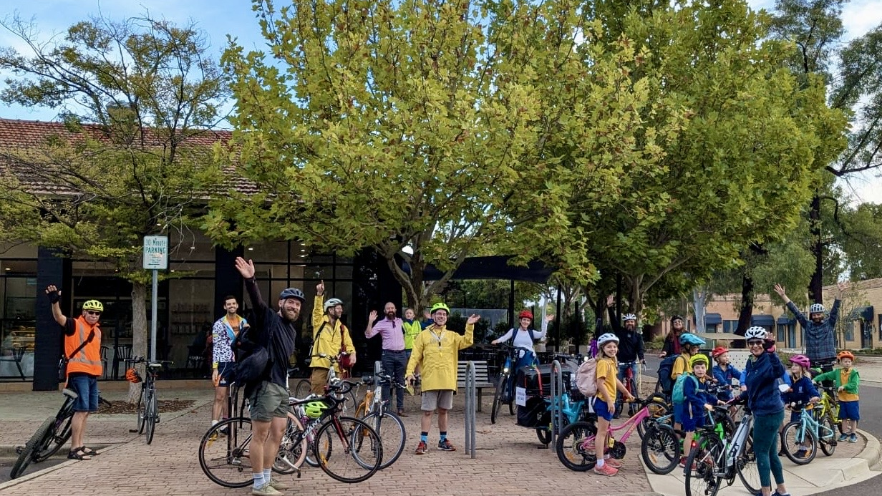


Not just commuting:
How active mobility can boost our quality of life

Slide 2
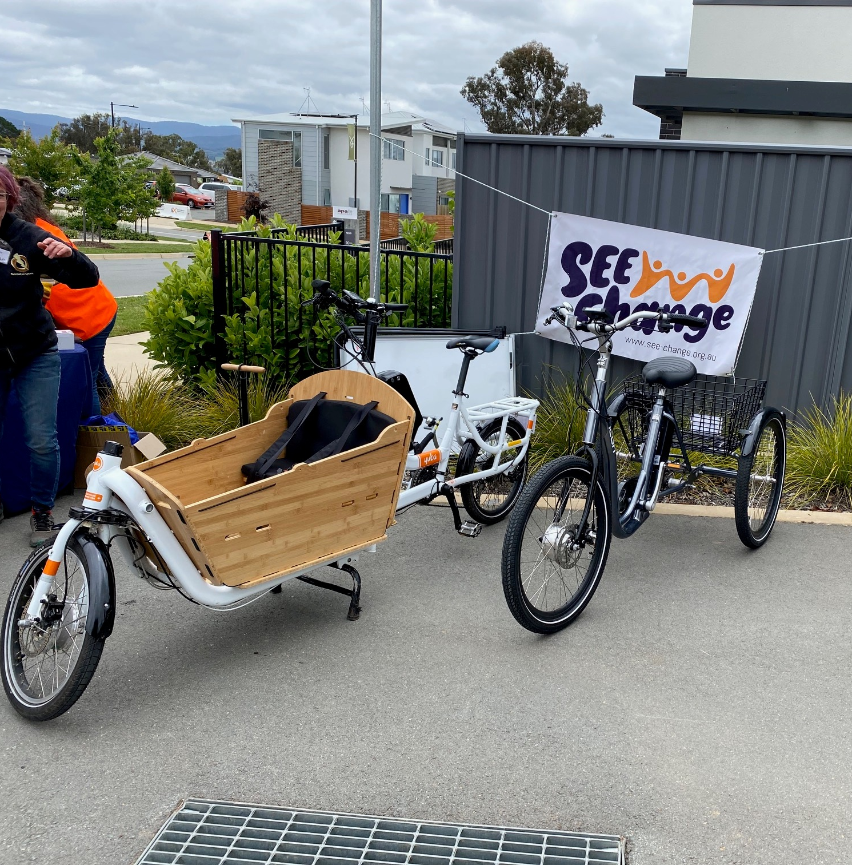
Bigger than just getting to work
How to address our ballooning healthcare costs? (1/3 of ACT Govt budget)
Preventive health measures like cycling and walking to local shops means incidental exercise
Fight loneliness, climate change, screentime, and noise pollution with one 19th century tool
Canberra electric bike library
Come and try day,
Gininderry, act

Slide 3
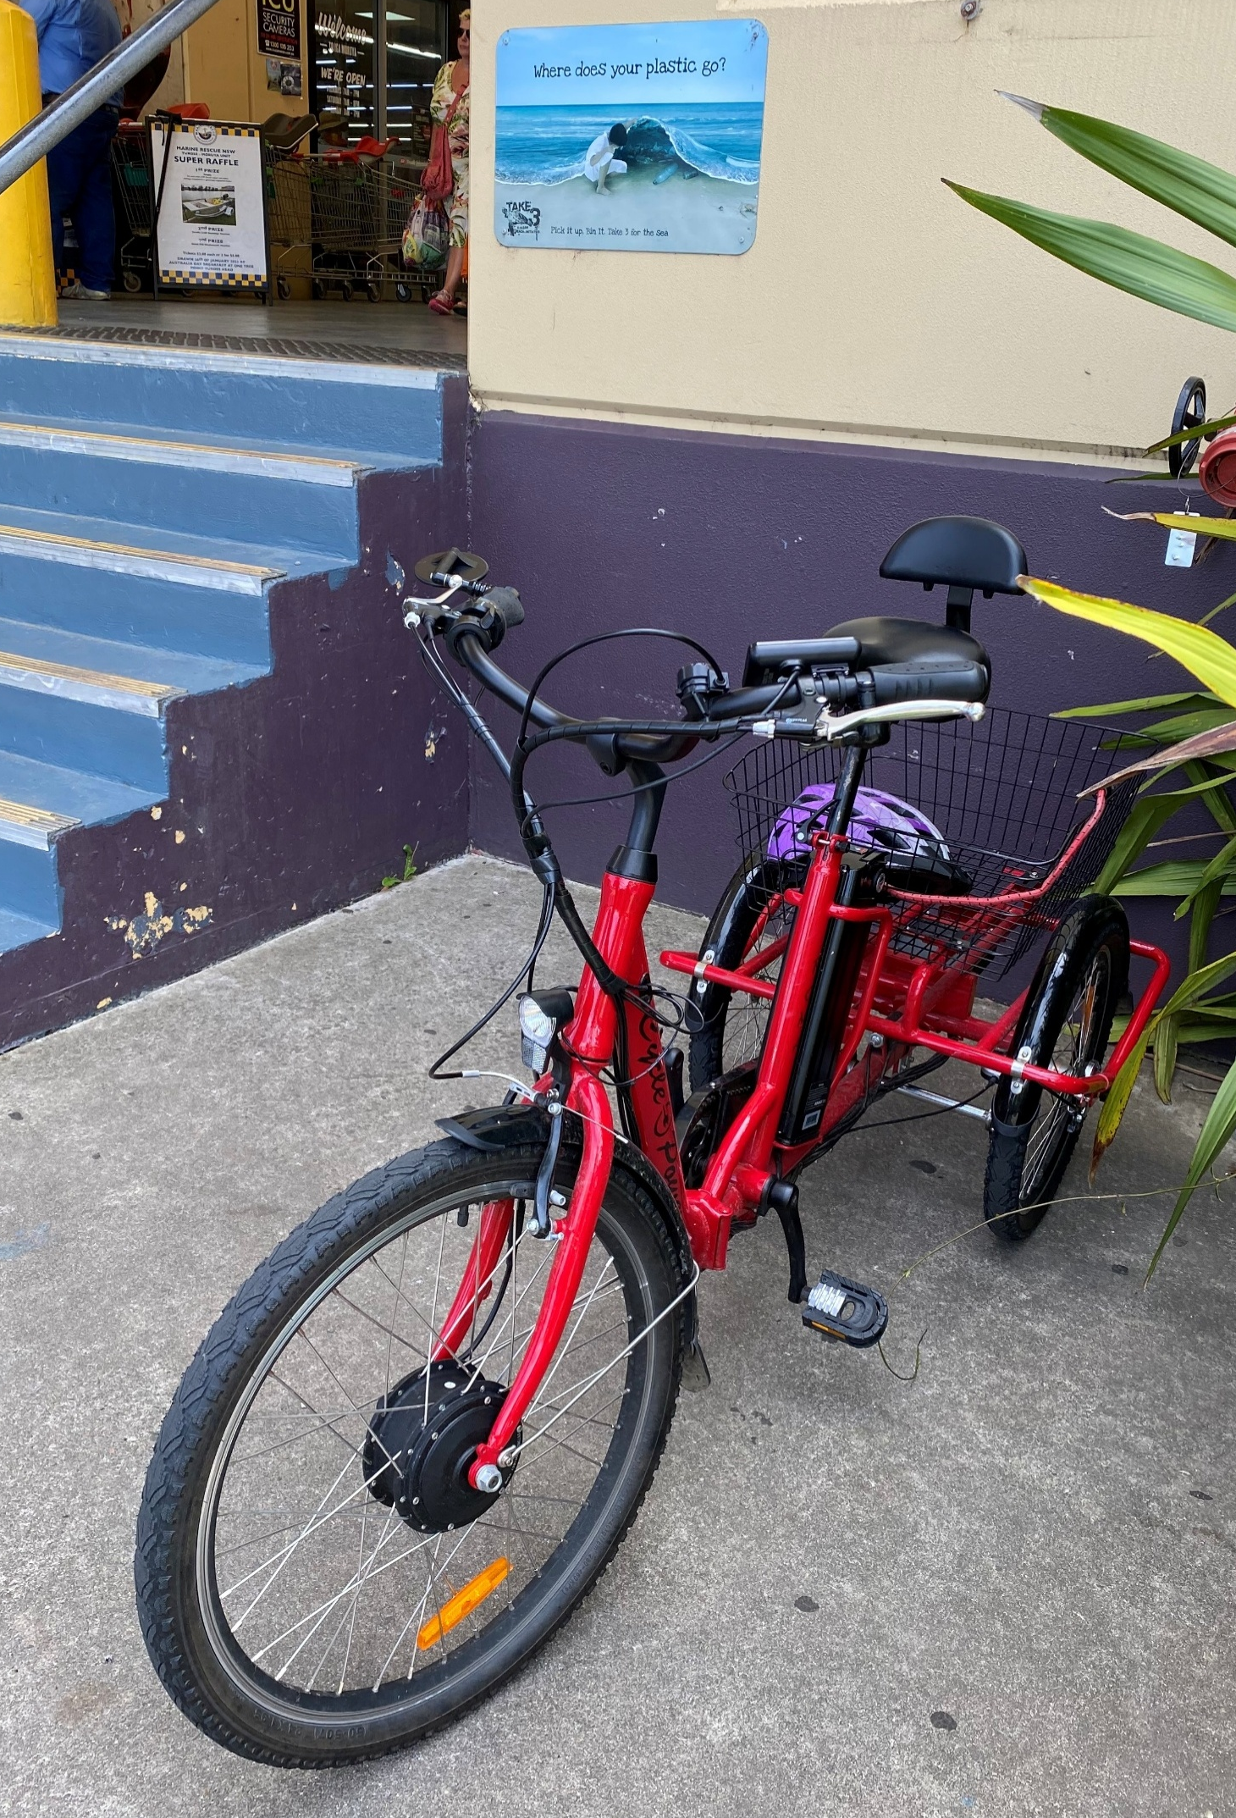
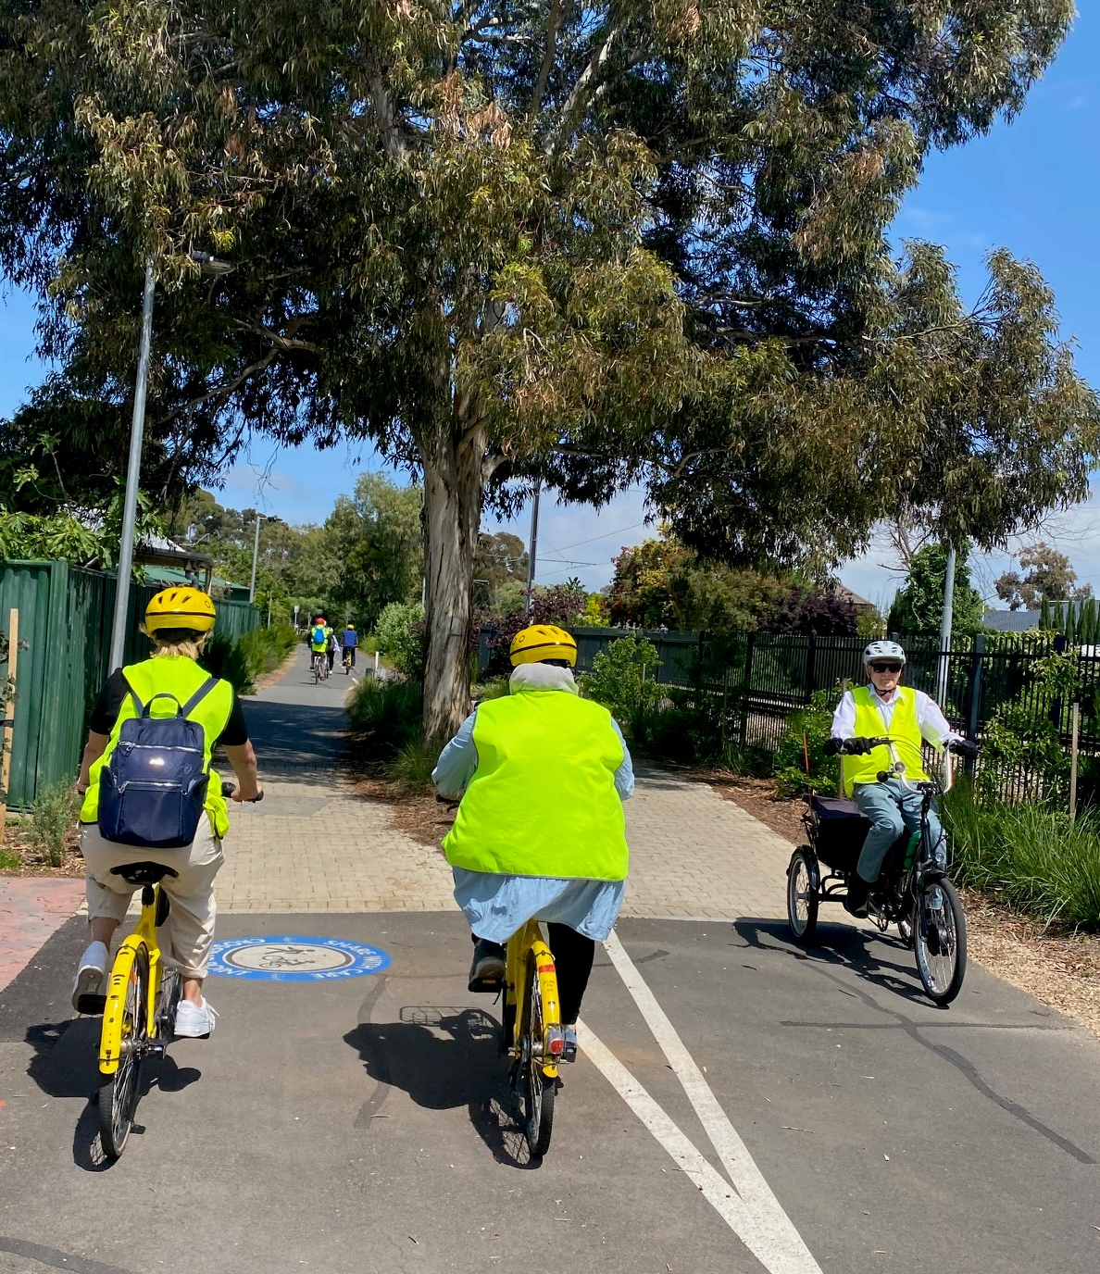
Cycles are everyday transportation
Not Gungahin to Civic, or Tuggeranong to Woden.
But short trips 5km and under
within a town centre, eg for shopping, social gatherings, medical appointments or education.
Adelaide, sa
Moruya, NSW

Slide 4
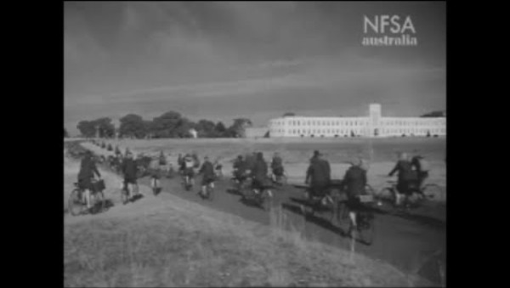
Back to the future? Canberra in 1945

Slide 5
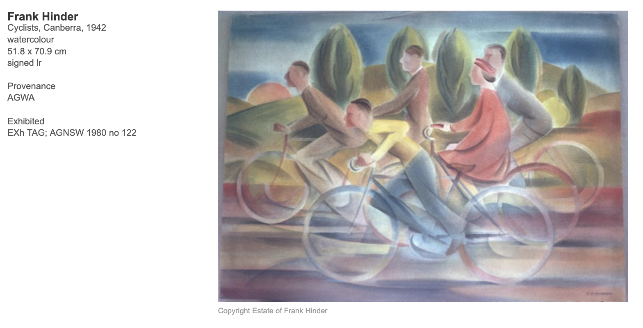
Frank hinder (1942 series)
Thanks martin miller for alerting me

Slide 6
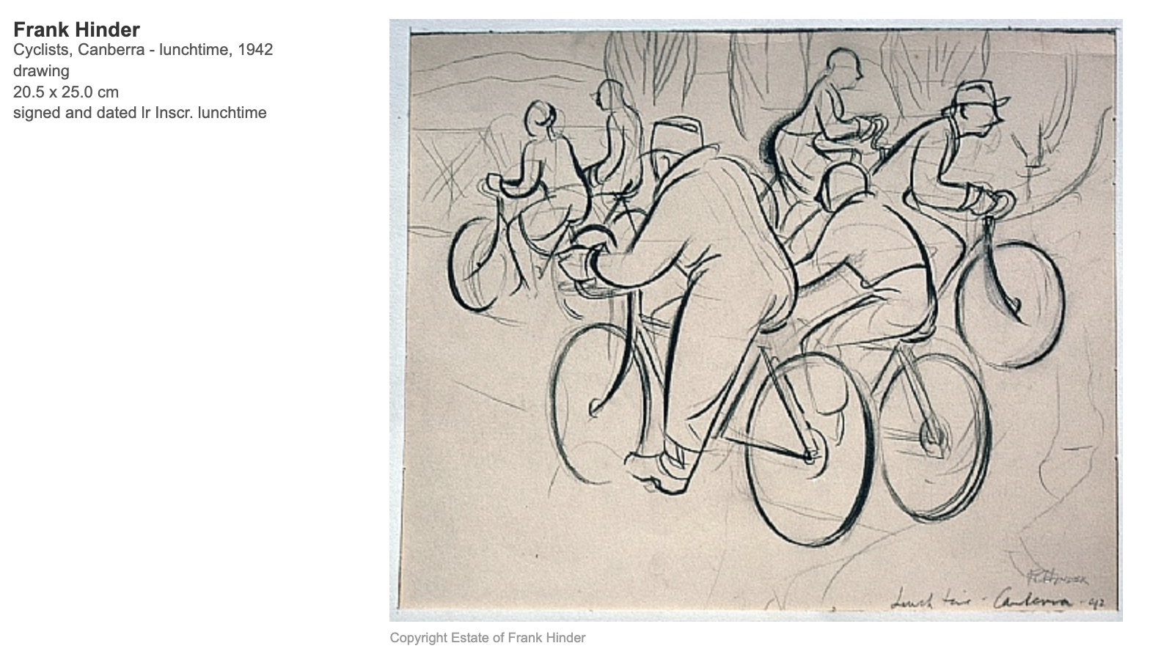

Slide 7
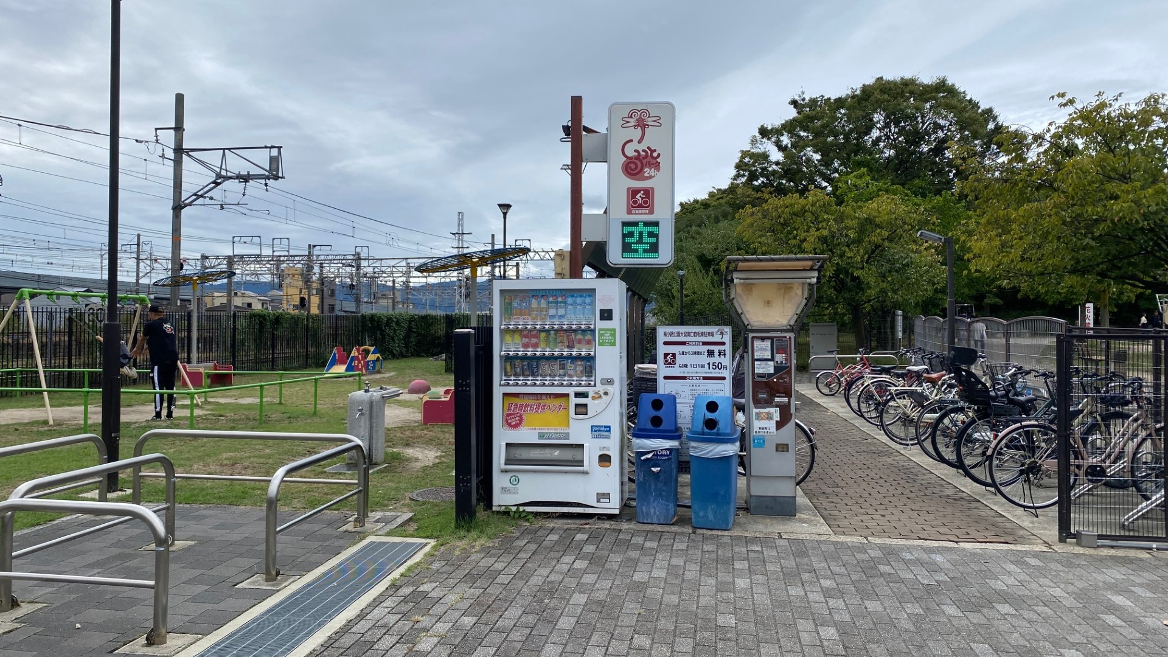
Kyoto Japan, oct. 2024

Slide 8
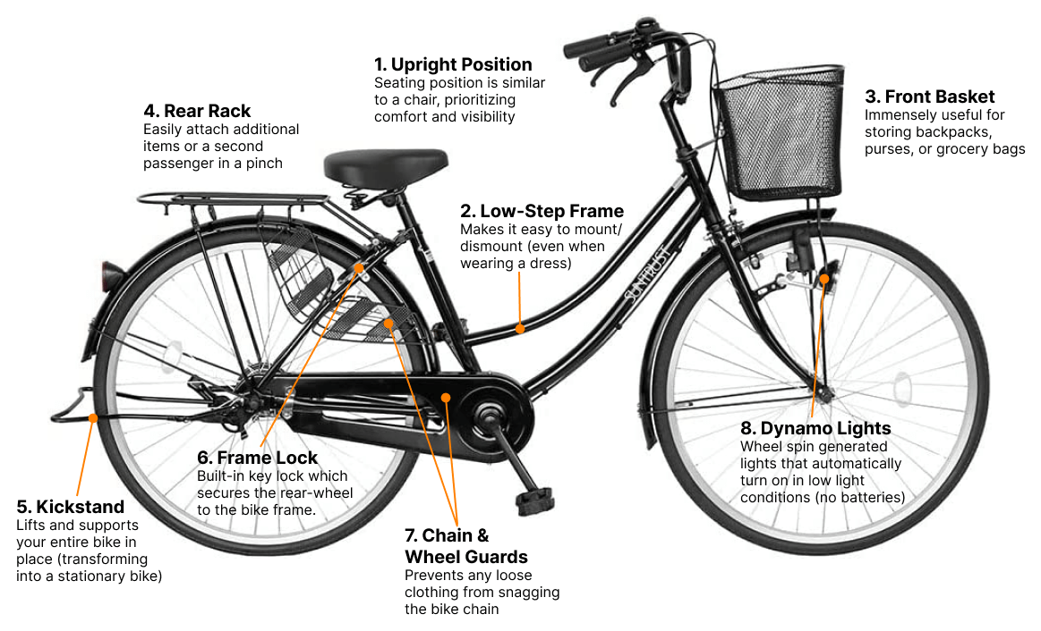
Choose the Best tool for the job
“Mama chari” – moving Japanese families since 1956

Slide 9
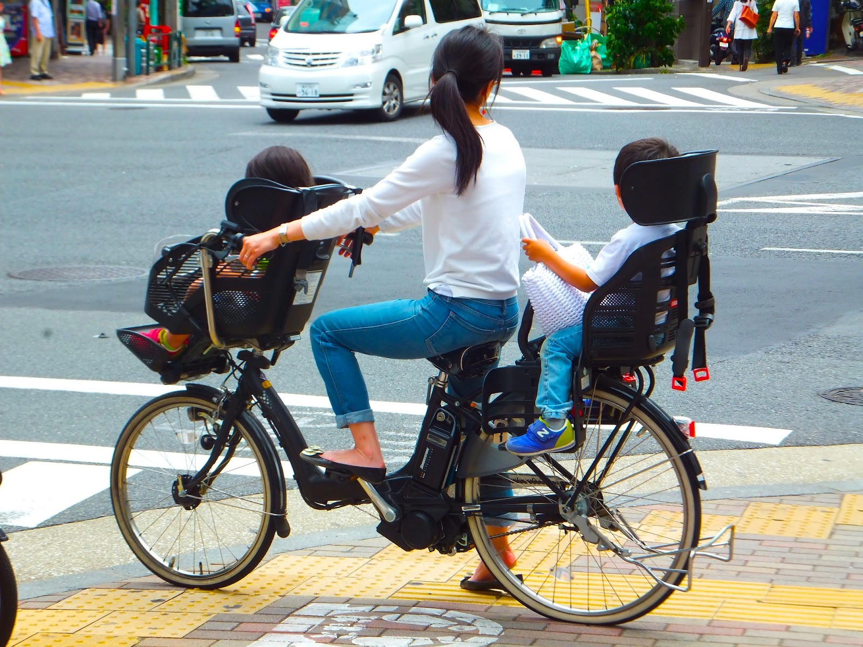
Choose the Best tool for the job
“Mama chari” – electric version

Slide 10
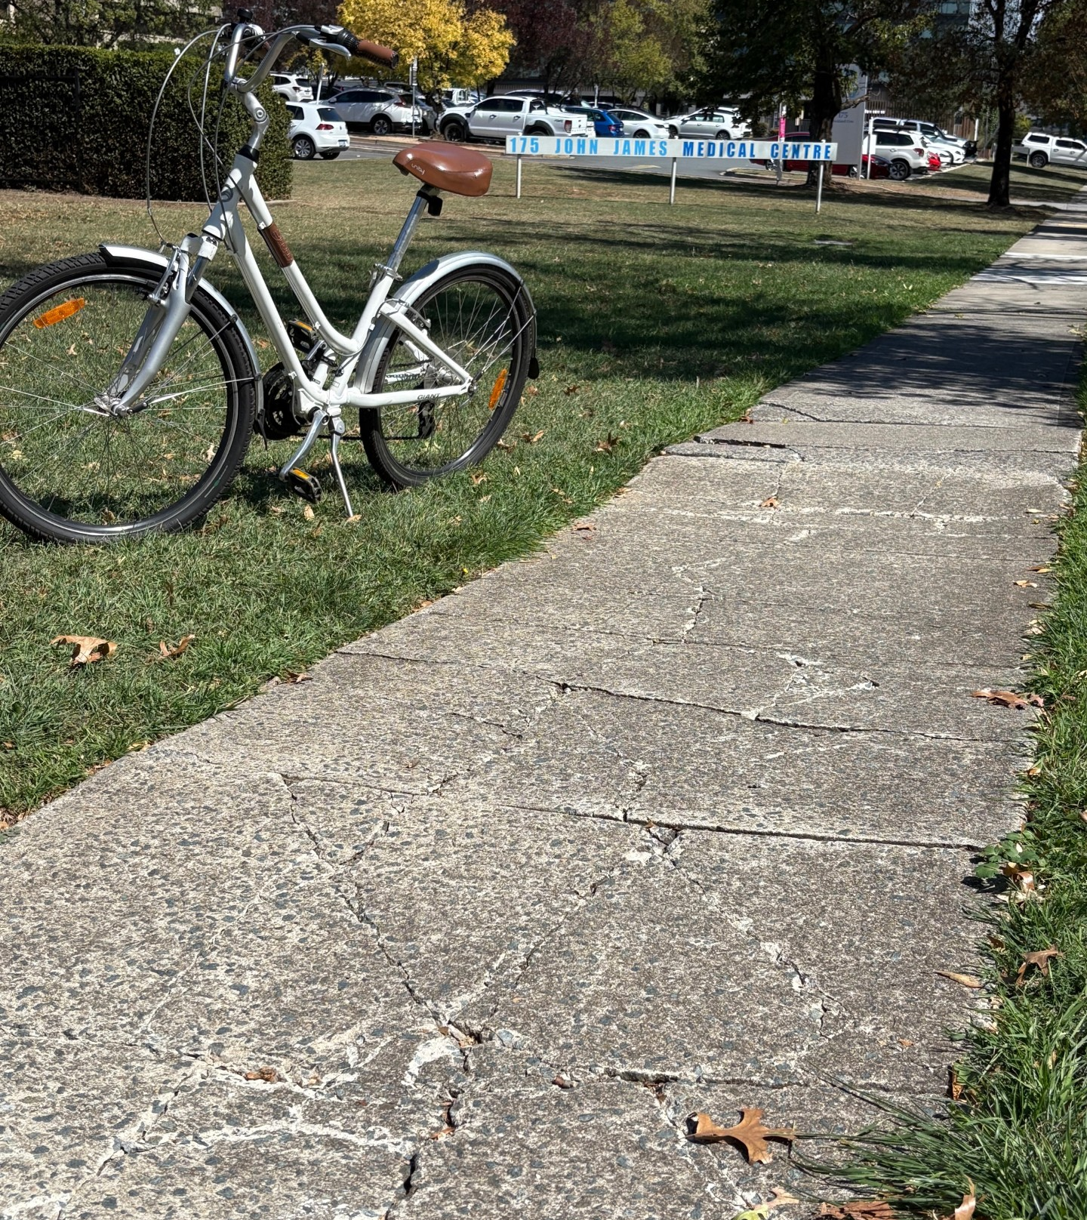
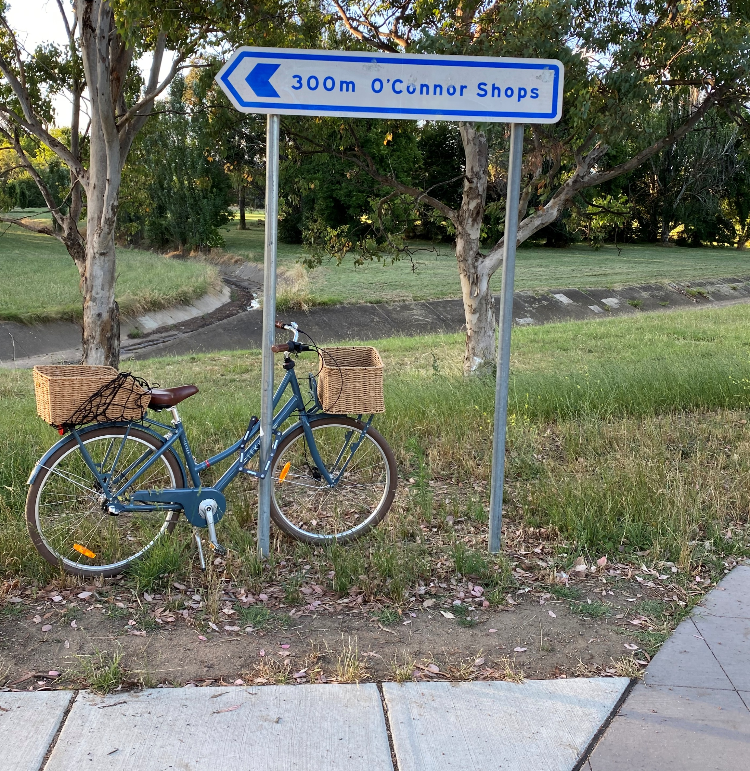
Does our infrastructure invite short trips for shopping or medical services?
Deakin’s health precinct
Sydney
Moruya, NSW
Yarralumla
kaleen

Slide 11
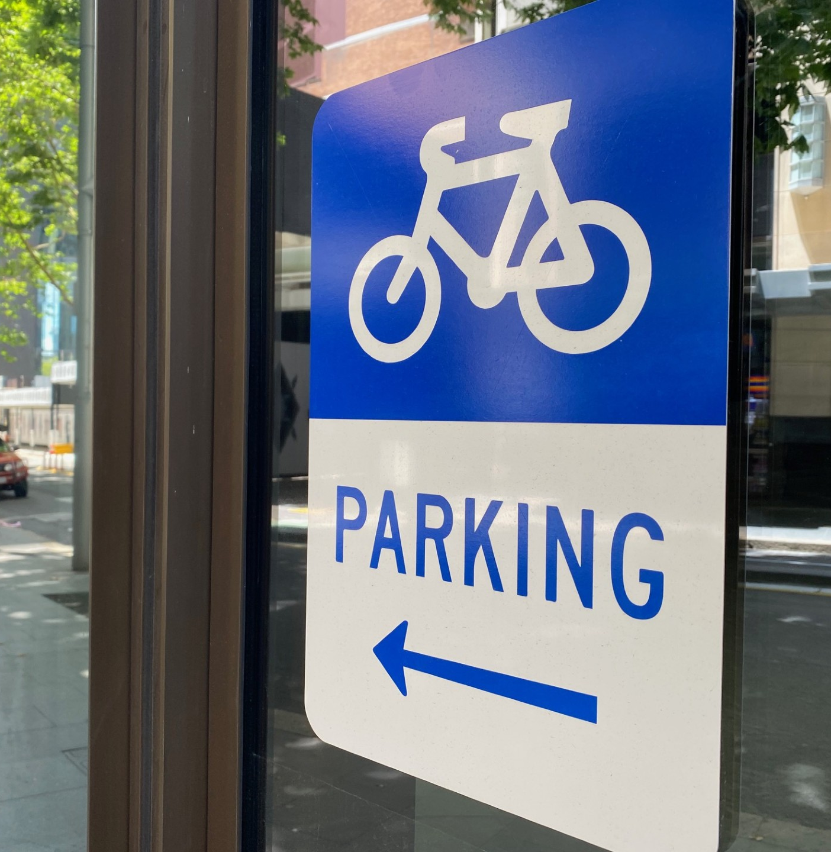
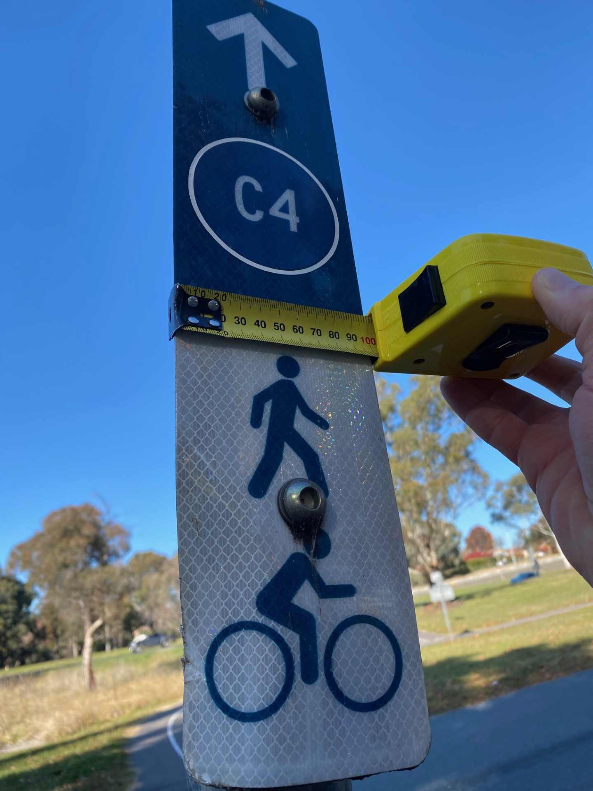
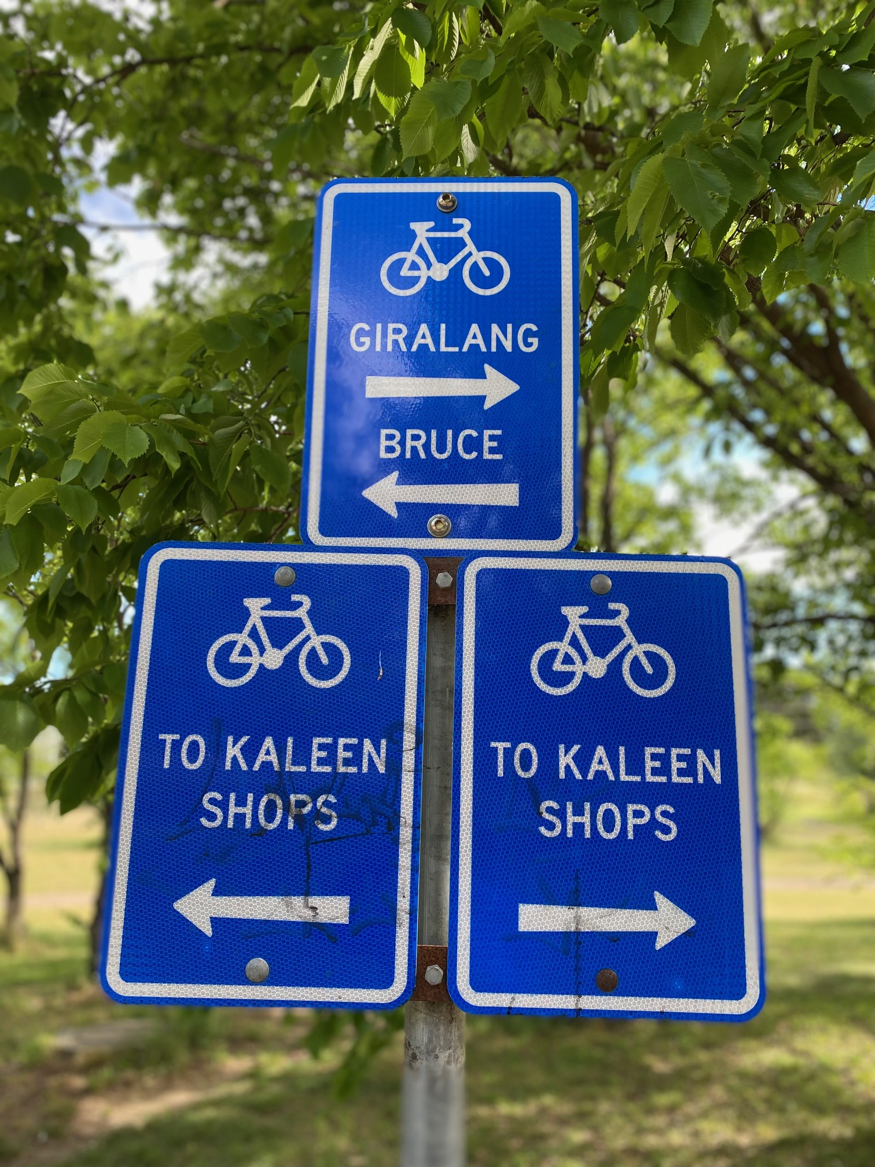
Good Wayfinding matters
Two colors is clear, especially at dusk
10cm too narrow – hard to see from distance
Sydney
Moruya, NSW
Yarralumla
kaleen

Slide 12
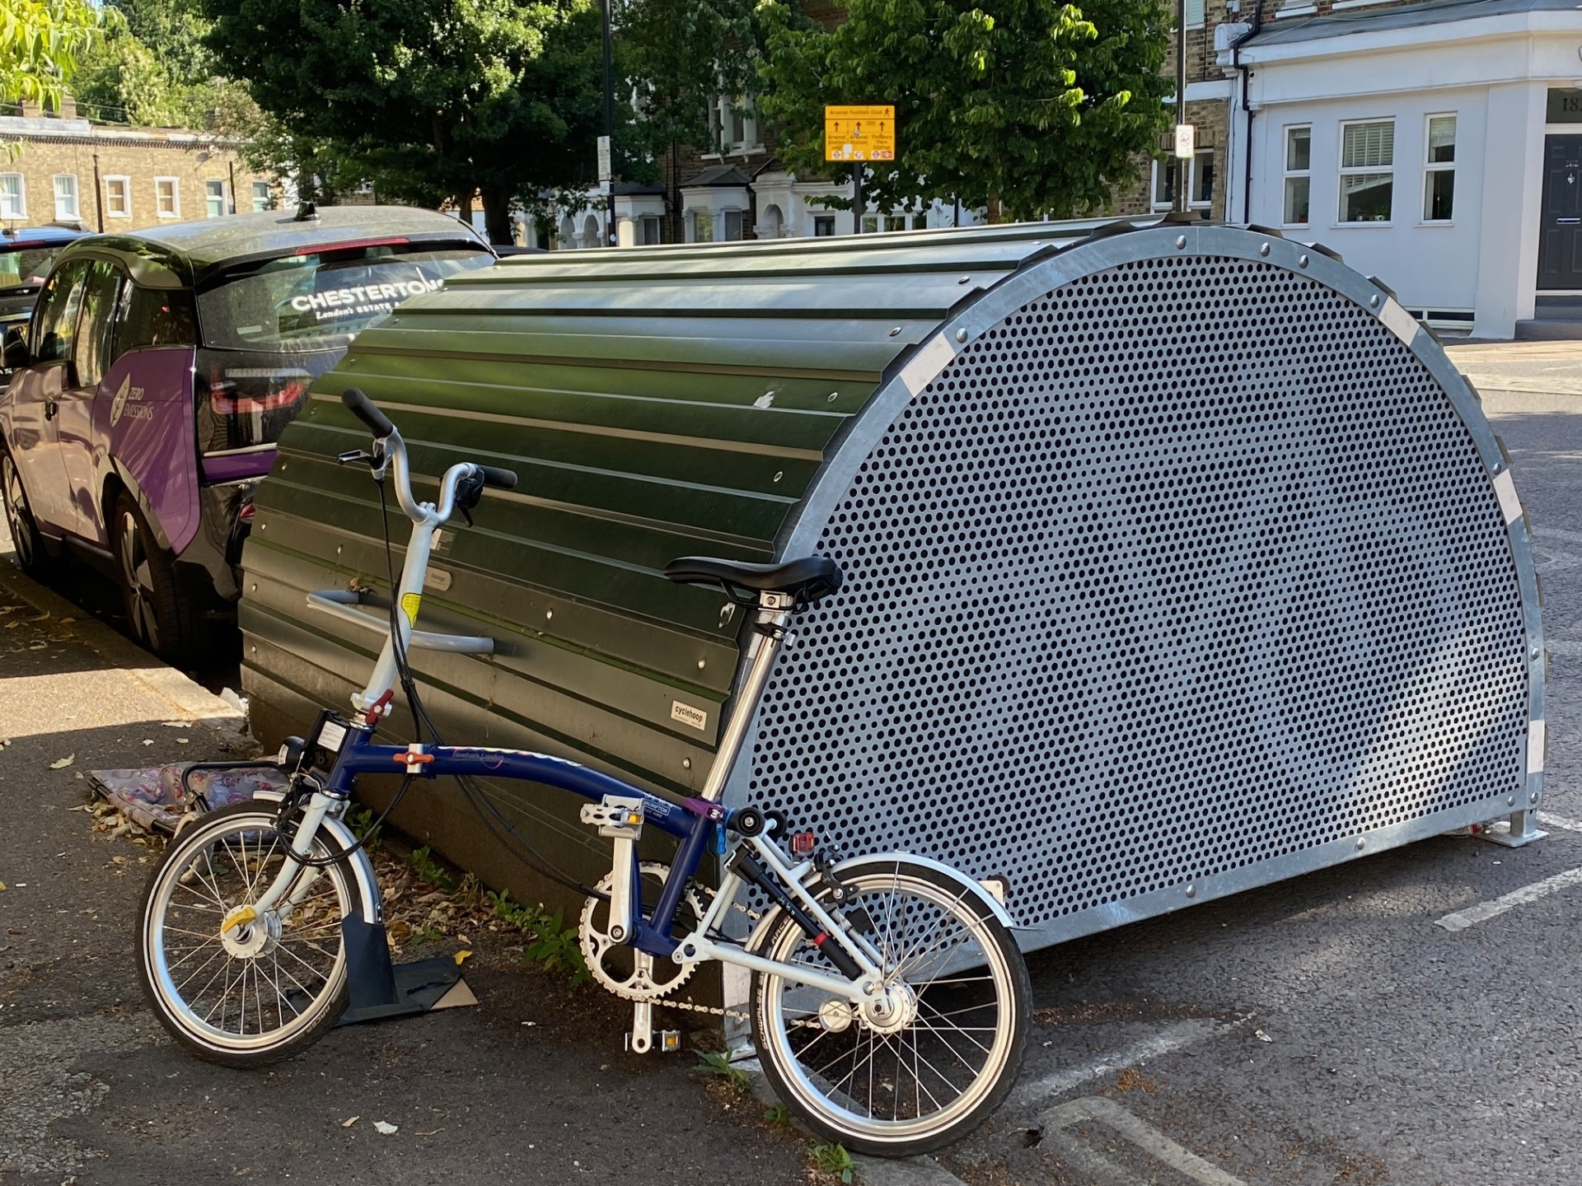
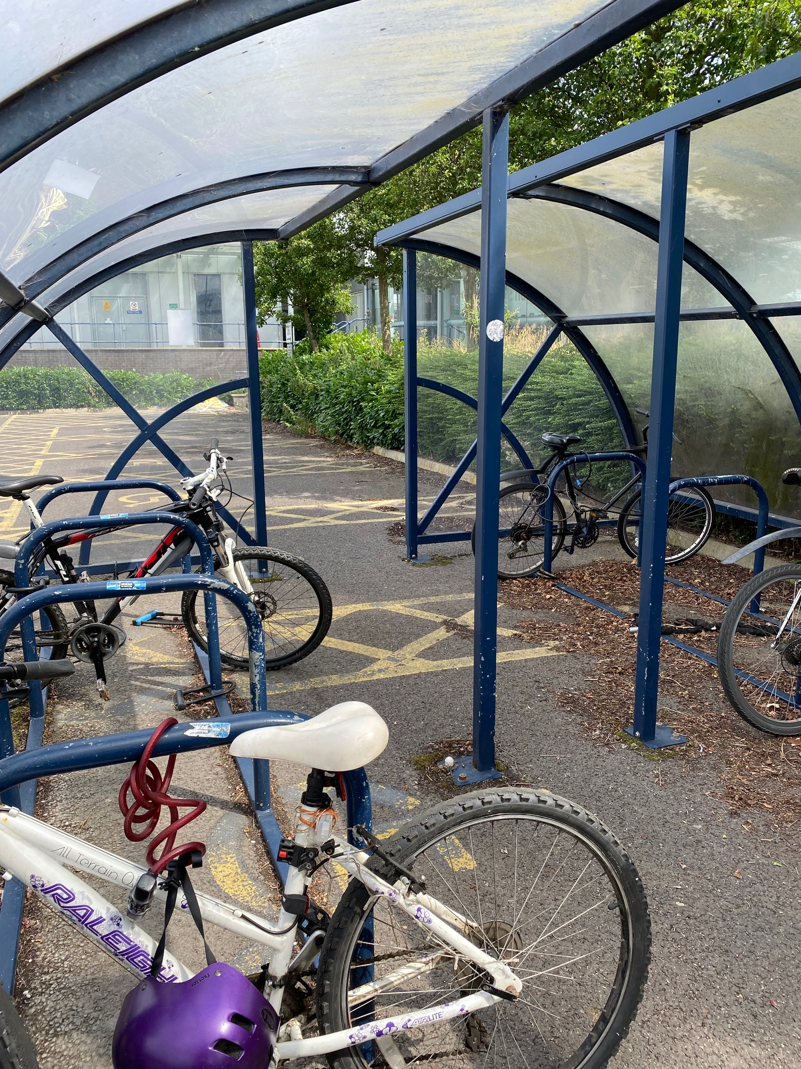
Secure, covered parking
People invest thousands in e-bikes. Theft, and fear of, is real.
Southend airport, england
Sydney
Arsenal, london

Slide 13
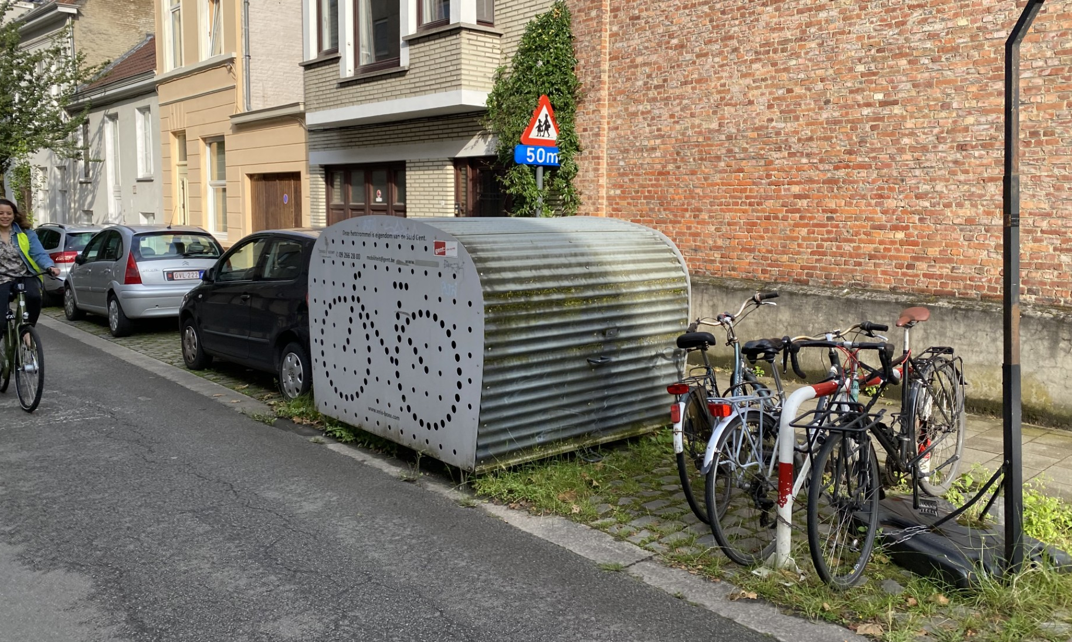
Ghent, Belgium, includes ‘daylighting’

Slide 14
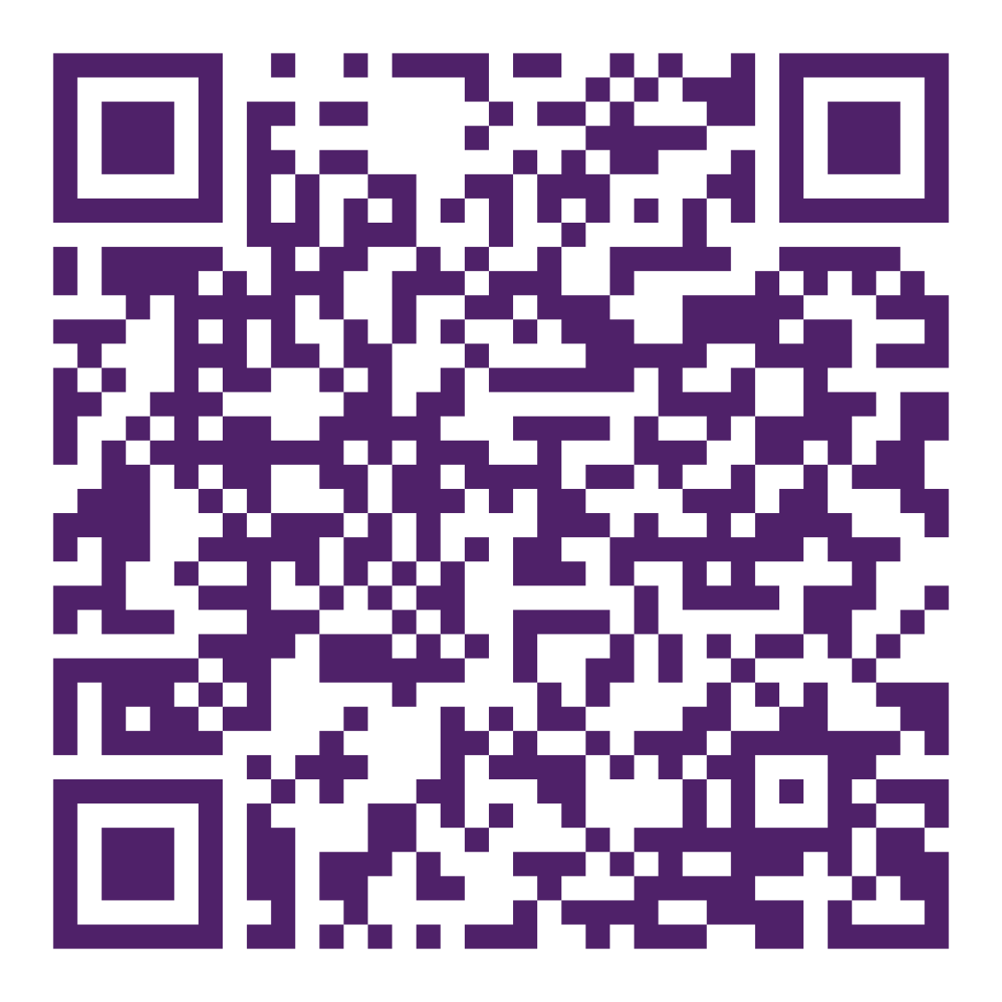
Rethink getting to education facilities
Are the links safe, convenient, and attractive?
Lack of choice is often mistaken for demand (Credit: Cul de sac, Arizona usa)
Slower speed on haydon drive, bruce? Uc, Cit, nursing home, hospital, and school.
Adelaide, sa
Moruya, NSW
Joint petition for trialing 30 zone in Lyneham

Slide 15
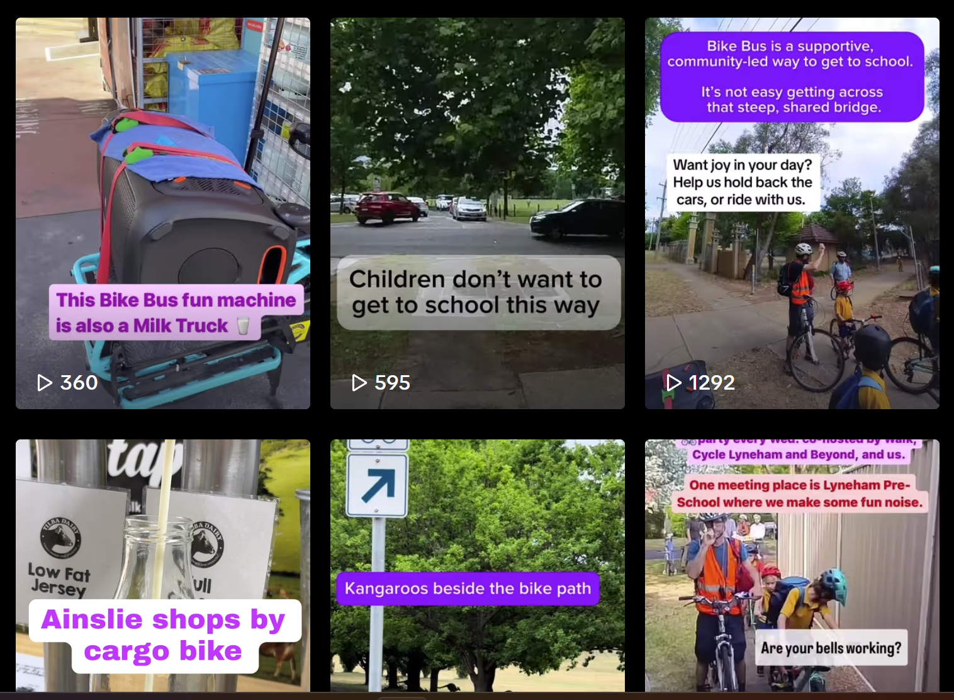
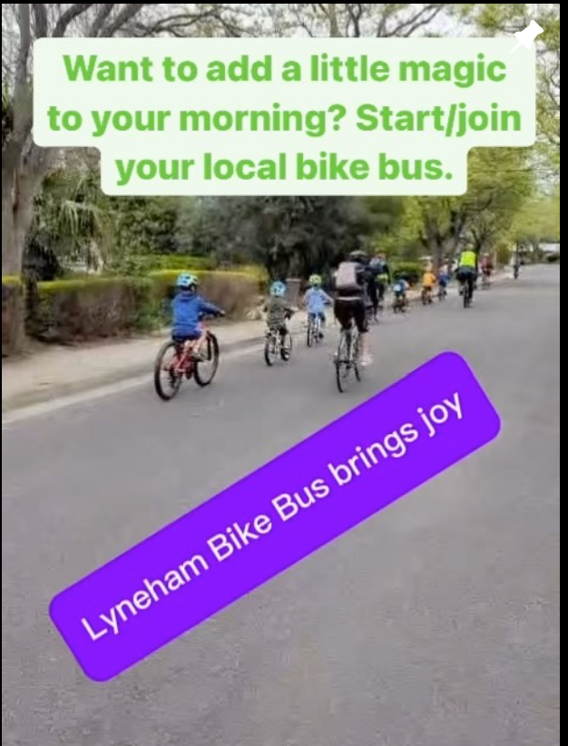
Come outside,Canberra!
Tiktok.com/@canberrabybike
instagram.com/canberrabybike

